Slide 1
String

Slide 2
Strings
A String in C programming is a sequence of characters terminated with a null character ‘\0’.
The String is stored as an array of characters.
A string must be terminated by a null – means that we need one byte extra for holding null character which is added by the compiler automatically.
Each character takes one byte in string.
The difference between a character array and a C string is that the string in C is terminated with a unique character ‘\0’.

Slide 3
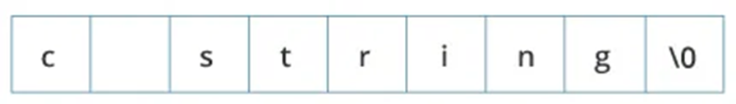
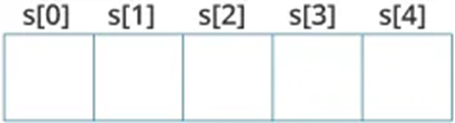
Strings Declaration
Declaring a string in C is as simple as declaring a one-dimensional array. Below is the basic syntax for declaring a string.
Example of a string –
char c[] = "c string";
Storage in memory
char s[5];
type string_name[size];

Slide 4
Strings Initialization
We can initialize a C string in 4 different ways which are as follows:
Assigning a String Literal without Size:
Assigning a String Literal with a Predefined Size: In that case, we should always account for one extra space which will be assigned to the null character.
char c[] = "abcd";
char c[50] = "abcd";

Slide 5
Strings Initialization
We can initialize a C string in 4 different ways which are as follows:
Assigning Character by Character with Size: In that case, we should remember to set the end character as ‘\0’ which is a null character.
Assigning Character by Character without Size: We can assign character by character without size with the NULL character at the end.
char c[] = {'a', 'b', 'c', 'd', '\0'};
char c[5] = {'a', 'b', 'c', 'd', '\0'};

Slide 6
Strings Initialization
Arrays and strings are second-class citizens in C; they do not support the assignment operator once it is declared. For example –
Note: We can use the strcpy() function to copy the string instead.
char c[100];
c = "C programming"; // Error! array type is not assignable.

Slide 7
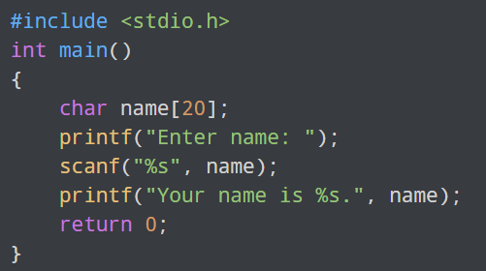
Read String from the user
We can use the scanf() function to read a string.
The scanf() function reads the sequence of characters until it encounters whitespace (space, newline, tab, etc.).

Slide 8
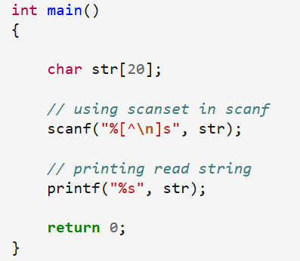
Read String Separated by Whitespaces
We can read a String Separated by Whitespaces in C by a small modification in the scan function –
Another way is to use gets function.

Slide 9
gets()
C’s standard library function
Uses the stdio.h header file
To use – call it using the name of a character array without any index.
gets() function reads character until we press ENTER
The ENTER key (carriage return - \r) is not stored, but is replaced by a null, which terminates the string.
char str[100];
gets(str);

Slide 10
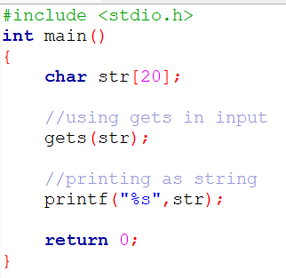
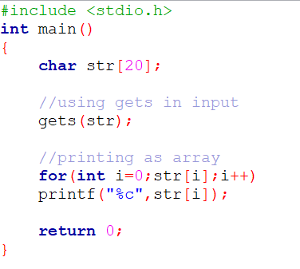
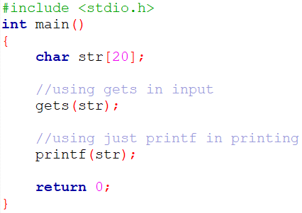
gets()

Slide 11
Be aware!
The string input function performs no bounds checking.
It is possible to enter more characters than the array receiving them can hold – unwanted result!
For example, if we call gets() with an array that is 20 characters long, there is no mechanism to stop us from entering more than 20 character.

Slide 12
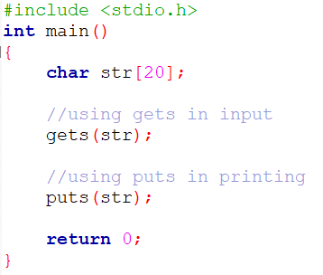
puts()
C’s standard library function
Uses the stdio.h header file
To use – call it using the name of a character array without any index.
char str[100] = “This is it”;
puts(str);

Slide 13
String Functions
The C language comes bundled with <string.h> which contains some useful string-handling functions.
The five most commonly used string library functions are –
strlen() – for finding length of a string
strcpy() – for copying of one string to another
strcat() – for concatenation
strcmp() – for comparing two strings
strrev() – for reversing the strings

Slide 14
strlen()
The strlen() function in C calculates the length of a given string. It doesn’t count the null character ‘\0’.
The strlen() function is defined in string.h header file.
strlen (str_name);

Slide 15
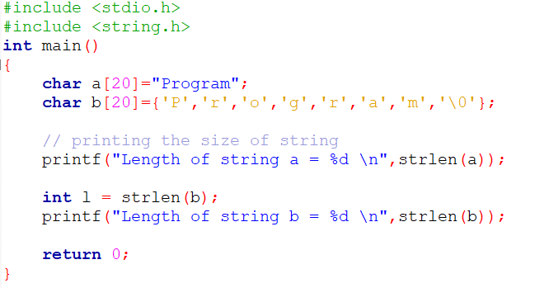

strlen()

Slide 16
strcpy()
The C strcpy() function copies the content of a string to another. The content of the destination string will be replaced with that of the source string by the strcpy() function.
It is defined inside <string.h> header file.
strcpy (to, from);

Slide 17
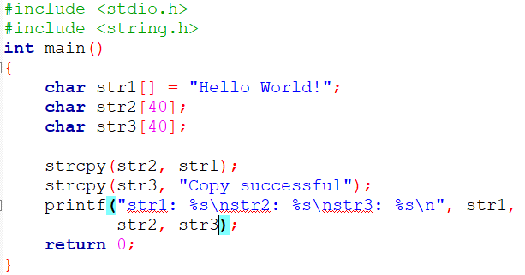

strcpy()

Slide 18
strcat()
C strcat() function appends the string pointed to by source to the end of the string pointed to by destination, plus a terminating Null character. The initial character of the string(src) overwrites the Null-character present at the end of the string(dest).
It is defined inside <string.h> header file.
strcpy (to, from);

Slide 19
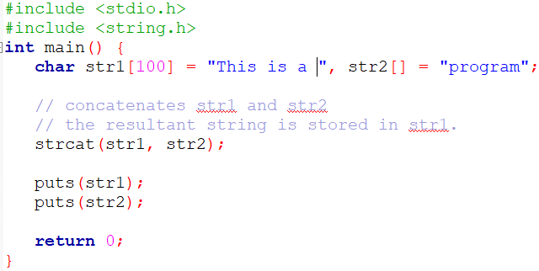

strcat()

Slide 20
strcmp()
This function takes two strings (array of characters) as arguments, compares these two strings lexicographically, and then returns 0,1, or -1 as the result.
It is defined inside <string.h> header file.
It returns zero – if s1 and s2 same (s1 = s2)
It returns less than zero – if s1 less than s2 (s1 < s2)
It returns greater than zero – if s1 greater than s2 (s1 > s2)
strcmp (s1, s2);

Slide 21
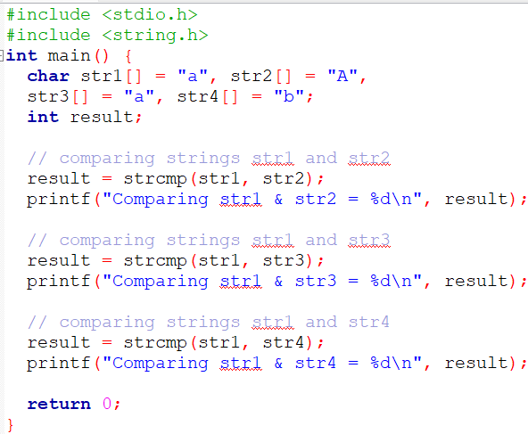

strcmp()

Slide 22
strrev()
The strrev() function is a built-in function in C and is defined in string.h header file. The strrev() function is used to reverse the given string.
It does not count the null terminator
It is defined inside <string.h> header file.
strrev(str);

Slide 23
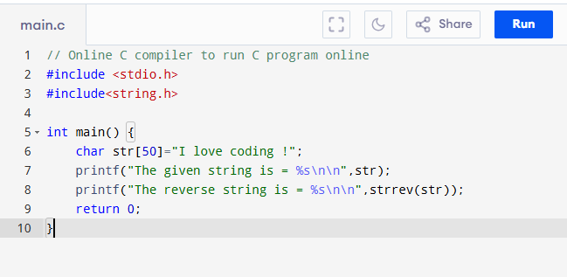
strrev()

Slide 24
Thank You

